Slide 1




Slide 2

Farm Bill and Communities of Color
Presenters
Carolina Guzman MPH, Program Manager, Prevention Institute
Lorette Picciano, Executive Director, Rural Coalition
Amalia Deloney, Grassroots Policy Director, Center for Media Justice
Moderator: AyeNay Abye, Policy Director, The Praxis Project

Slide 3
OVERVIEW OF THE WEBINAR
CCHE and The Farm Bill
Farm Bill Overview
The Farm Bill and Racial Justice
Current Approaches, Challenges, Gains and Strategies
Questions and Answers

Slide 4
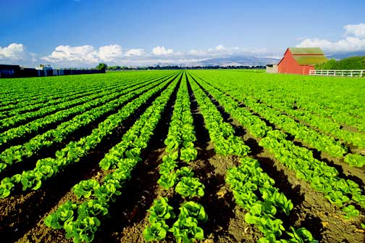
What is the Farm Bill?
The farm bill is a set of federal laws that establishes the general direction for America’s farm and food policy.
Reauthorized roughly every 5 year
  Authorizing committees include:
    The House Committee on Agriculture
    The Senate Committee on Agriculture, Nutrition and Forestry
The current Farm Bill, passed in 2008 is called The Food, Conservation, and Energy Act.
Notes:
It’s been said that The Farm Bill should be re-named The Food Bill, because it influences what we eat every day — from the cost, quality and availability of food, to the tools available to communities to protect farm and ranch land.

Slide 5
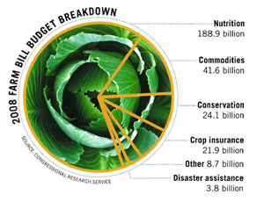
Farm Bill Spending
4 areas make up the bulk of the Farm Bill’s spending

Slide 6
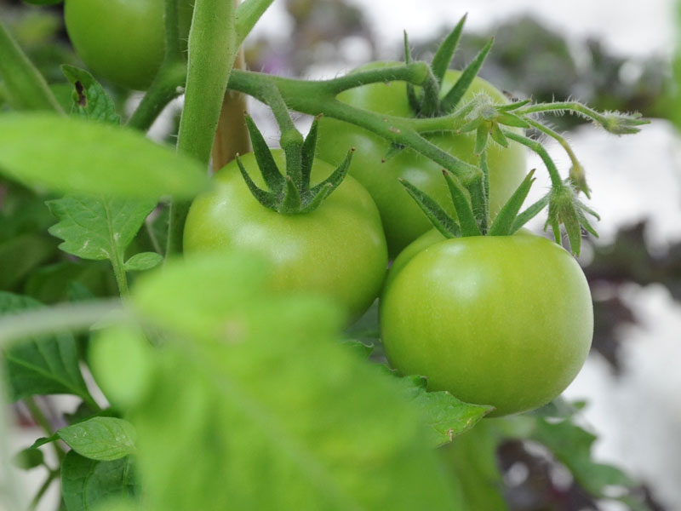
2008 Farm Bill Titles
Title I- Commodity Programs
Title II- Conservation
Title III- Trade
Title IV- Nutrition Programs
Title V- Credit
Title VI- Rural Development
Title VII- Research
Title VIII- Forestry
Title IX- Energy
Title X- Horticulture & Organic Agriculture
Title XI- Livestock
Title XII- Crop Insurance
Title XIII- Commodity Futures
Title XIV- Miscellaneous
Title XV- Trade & Taxes

Slide 7
Changes and Enhancements to the 2008 Farm Bill:
Local and Healthy Food Initiatives
Notes:
The 2008 Farm Bill, the Food, Conservation, and Energy Act, was notable in its response to the increased awareness of Americans about the provenience of their food as well as the environmental costs, inequities, and health impacts of our food system. Below are local and healthy food initiatives included in various Titles, with estimated costs:

Slide 8
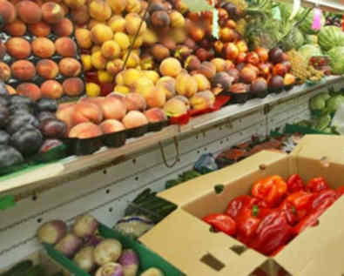
2008 FB Improvements
Title IV: Nutrition
Supplemental Nutrition Assistance Program
Makes nutrition education activities a specific component of legislation and gives States discretion to implement nutrition education programs directed at individuals who receive or are eligible for program benefits
Mandates $20 million to carry out point-of-purchase pilot to encourage households to purchase fruits, vegetables, or other healthful foods

Slide 9
2008 FB Improvements
Title IV: Nutrition
Supplemental Nutrition Assistance Program
Authorizes funding as needed for pilot projects for each of FY 2008-12 to develop and test strategies for:
    Using program to improve diet and health status among eligible population
    Reducing obesity and diet-related disorders in U.S. population
      Requires independent evaluations of all pilot projects.

Slide 10
2008 FB Improvements
Title IV: Nutrition Continued
Food Distribution Program on Indian Reservations (FDPIR)
  Authorizes $5 million annually for FY 2008-12 for fund to purchase and distribute traditional and locally grown foods, designated by region, on Indian Land.
  Where practicable, at least 50% of food distributed through the fund must be produced by American Indian farmers, ranchers, and producers.

Slide 11
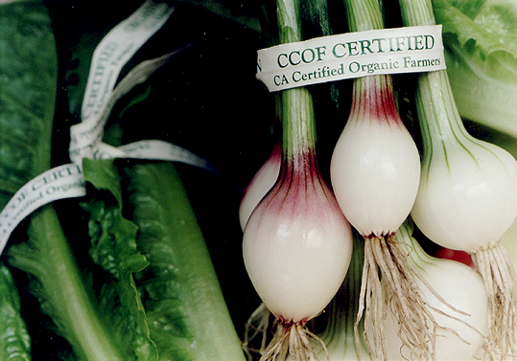
Improvements to School Food
Expansion of the Fresh Fruit and Vegetable Programs- schools can be added to the program based on the proportion of students receiving free and reduced lunch.
Purchases of Locally Produced Foods - The bill eases bidding restrictions for school districts trying to acquire locally grown foods. With this new language, school nutrition programs could use geographic preference in procuring locally grown items
Healthy Food Education and Program Replicability - making grants available to "high-poverty" schools for school garden initiatives. The bill also encourages the USDA to sponsor projects that promote nutrition education that can be replicated in schools.

Slide 12

Challenges in the current Farm Bill
Generally not supportive of community food systems
Commodity programs do not support local agriculture
Local food system funding, particularly in urban areas is limited
Nutrition allocation and emphasis on healthy food options is inadequate

Slide 13
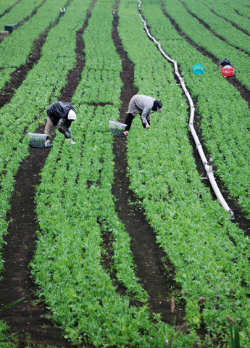
Limitations of the Farm Bill for Communities of Color
Title I Commodity Programs: crop subsidy programs systematically fail to support small farms, and this disproportionately impacts farmers of color. For example:
  The Southern Rural Development Initiative found that less than 1 percent of agriculture subsidy payments between 2001 and 2003 went to Blacks, American Indians and Asian Americans.
Notes:
(Because the available data comes from the Census Bureau, whose definition of “nonwhite” excludes many Latinos, the researchers were unable to include Latino farmers within its people of color analysis.) Even in counties where people of color are the majority, researchers estimate that at a minimum, almost 95 percent of agriculture subsidies “are going to farms with white operators.”
Federal crop subsidies go to commodity crops like corn, cotton and rice that require large farms, and most large farms in the U.S. are white-owned. So even when USDA dollars move to counties where people of color are the majority, they largely end up in the hands of the white landowning minority. The report by the Southern Rural Development Initiative put it bluntly: “USDA perpetuates the legacy of the Deep South’s anachronistic, inequitable economy through its agricultural subsidy programs.”

Slide 14
Limitations of the Farm Bill for Communities of Color
Title IV Nutrition:
  Does Not Adequately Provide Indigenous Communities with the ability to include traditional foods in nutrition and commodity programs
  Expand programs to help elderly and low income Americans shop at farmer's markets; adherence of school nutrition programs to dietary guidelines and expansion of opportunities for nutrition education in schools
  Expand Urban centered Programs, like Healthy Urban Food Enterprise Development Centers

Slide 15
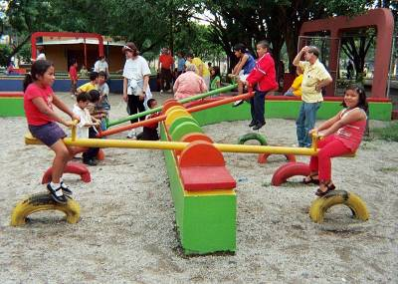
Farm Bill Players
Agribusiness lobby
Anti-hunger advocates
Nutrition/Public health
Community Food security
Conservation/Environmental groups
Organic groups
Sustainable Agriculture
Native Nations
Renewable Energy
Government Agencies
Faith-Based Organizations
Small farmers
Latino, Black and Asian farmer groups

Slide 16
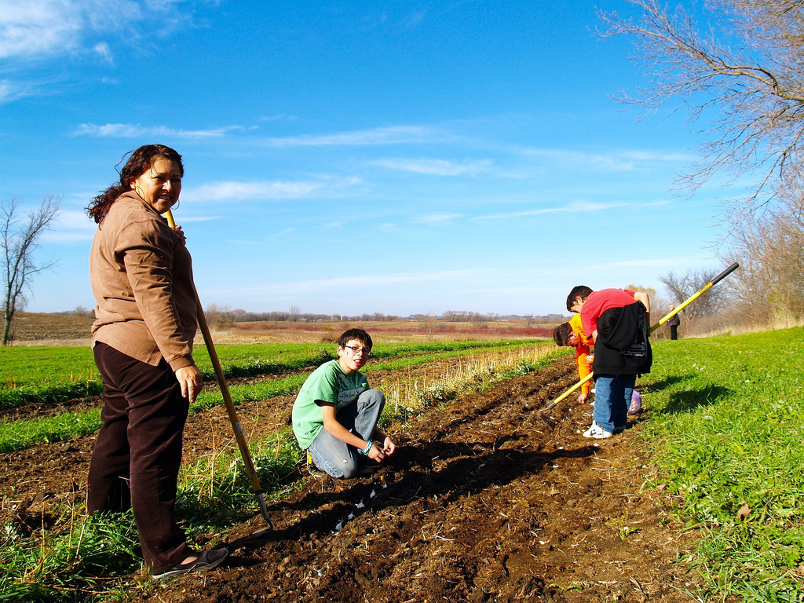
The Farm Bill and Racial Justice

Slide 17
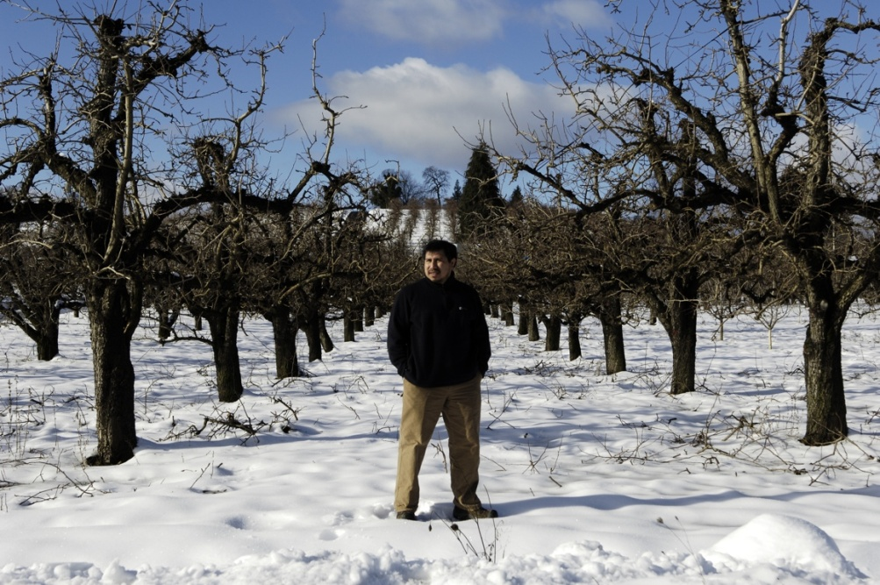
Racial Justice Framework
Points out the systemic and interrelated causes of persistent injustice (i.e. poverty, homelessness, malnutrition, etc.).
It emphasizes the powerful impact of inter-institutional dynamics, institutional resource inequities and historical legacies of racial inequalities today.
Emphasizes context within which we are attempting to create social, economic and political change.

Slide 18
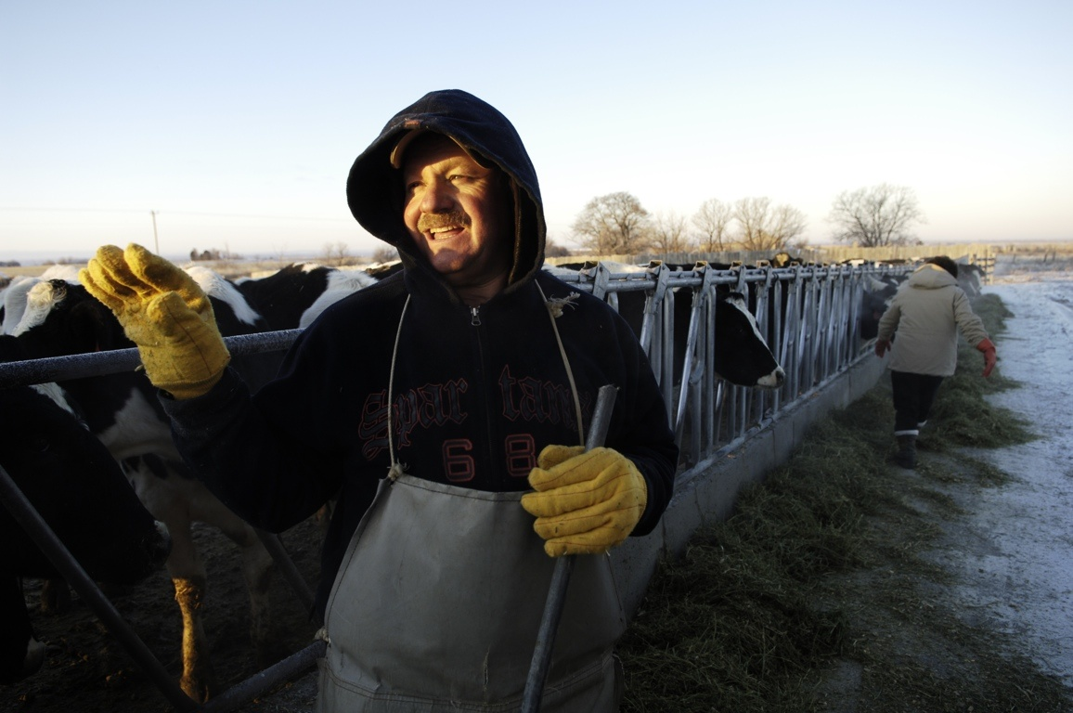
We Need Justice in Our Food System
Agriculture is not only how we grow food, but the entire food chain including the workers that help to plant the seeds, harvest the crops, package the food, deliver the product and serve the meal to consumers.
Policies in the Farm Bill affect not just farmers but rural and urban communities, the environment, health, hunger and even immigration.
The Farm Bill helps to shape the health, equity and long-term economic and environmental sustainability of the U.S. farm and entire food system.
Like Racial Justice, Food Justice addresses root causes. Food justice represents a transformation of the current food system, including (but not limited to) eliminating disparities and inequities.
A social change approach involves making significant changes on a systemic level, conflict with those who hold power is often inevitable. The power that social change organizations bring to the table is their ability to organize, to educate and to mobilize

Slide 19
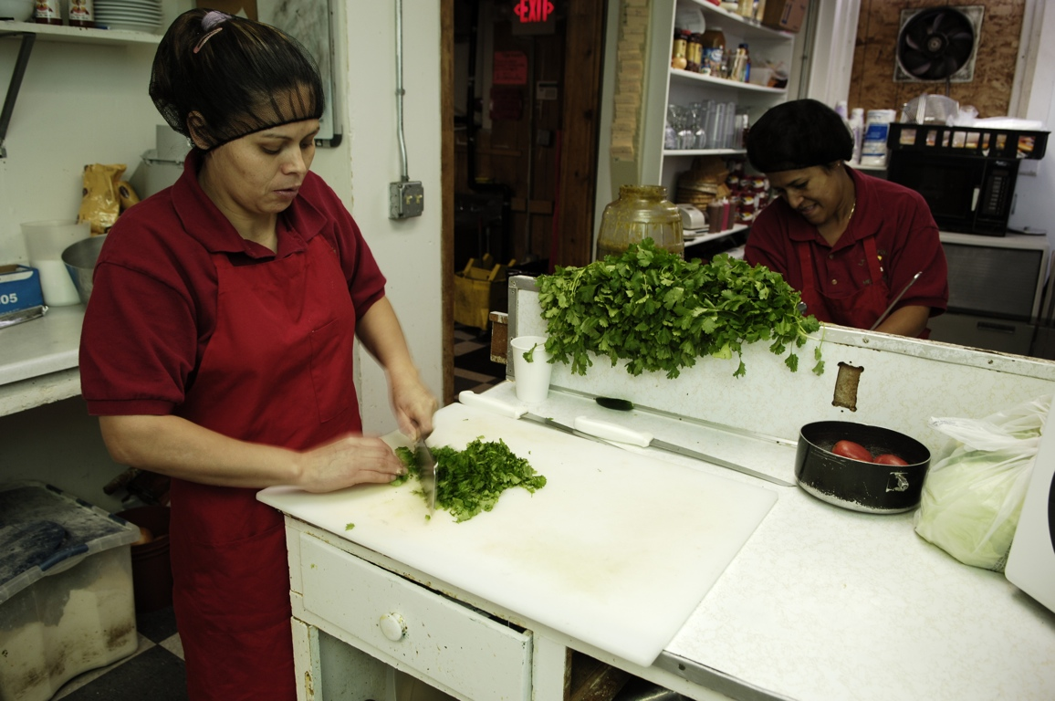
Building a Movement: Connecting the Dots
Key questions:
Who’s got the power?
Who’s at the table?
How are we taking collective action?
Example:
We must not ignore workers and their livelihoods. Food justice must involve increasing their wages and improving their working conditions, so that they too can enjoy healthy and sustainable lives.
Core Values:
Builds community-based responses, not solutions that leave the underlying social problems intact
Changes attitudes, behaviors, laws, policies and institutions to better reflect the justice based values
Insists on accountability and responsiveness among institutions, including the government, large corporations, universities and other entities whose policies and actions profoundly affect the living conditions of individuals and communities
Expands the meaning and practice of "democracy" by involving those closest to social problems in determining their solutions

Slide 20
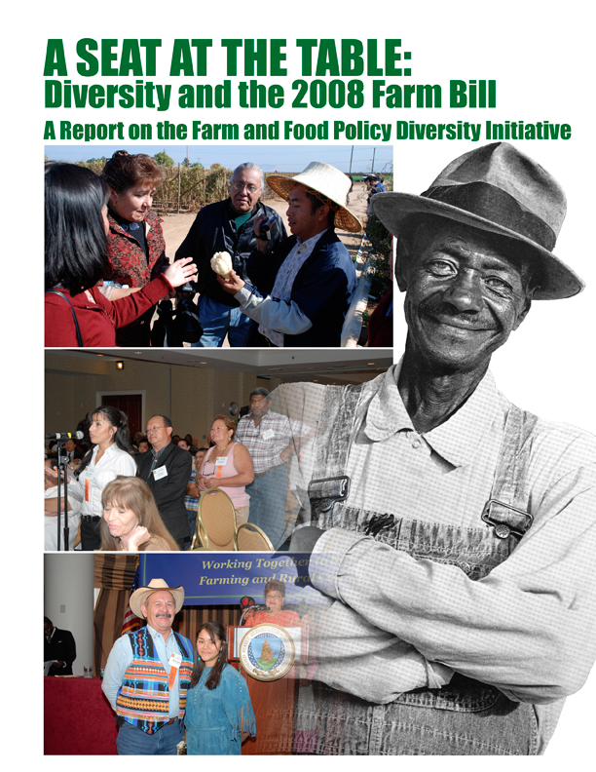
The Farm and Food Policy Diversity Initiative, coordinated by the Rural Coalition for the 2008 Farm Bill debate, was designed to ensure that organizations serving people of color in the food system have the opportunity to link their own initiatives into a comprehensive agenda of food and agriculture policy proposals developed by the Farm and Food Policy Project.
The Initiative supported the efforts of its partners to strengthen and diversify the content of farm bill policy agendas of critical allies and build bridges between the diverse leaders engaged in food and farm policy development with the overall goal of securing access to the same opportunities that have benefited other producers.
Outcomes: More than 30 Sections of Policy were included in the final Farm Bill, creating new USDA offices and accountability and bringing more than $3 billion to people of color communities.

Slide 21

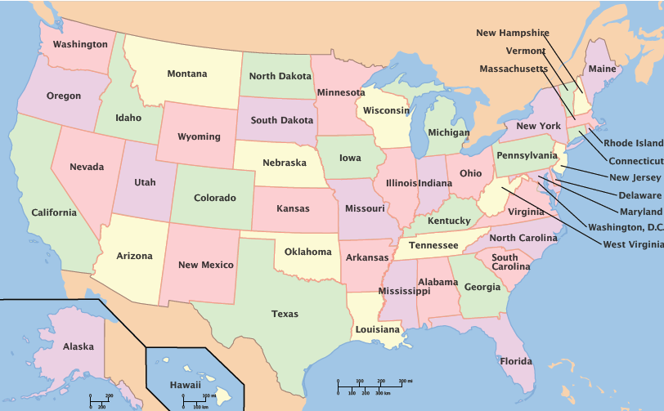

Working Together for a Just Farm Bill:
Over a dozen partner groups working in more than 15 states led an organic and strategic campaign by leveraging the individual organizational relationships and credibility that each of them had built with elected representatives.
The FFP Diversity Initiative Policy Team developed a comprehensive shared policy agenda that was translated into legislation.
Their work, more valuable together, proved an invaluable resource to the Congressional Black, Hispanic, Asian Pacific American and Progressive Caucuses.
Rural Coalition
www.ruralco.org

Slide 22
DI Highlight: Increased Environmental Quality Incentive Program Payments for Socially Disadvantaged Producers
The Conservation Title includes language providing cost share rates of up to 90% and advance payments up to 30% for socially disadvantaged, limited resource, and beginning farmers and ranchers. Thus, up to 90% of approved conservation practices could be paid by USDA Natural Resources and Conservation Service.
HIGH TUNNELS or Hoop Houses were approved as a conservation practice based on comments submitted to NRCS by Rural Coalition and allies.
Outcome: By September 2010, the farmers at Flats Mentor Farms in Lancaster, MA, received funds for 8 high tunnels. Farmers across the country who had never signed up for USDA programs came back in the door to seek high tunnels.

Slide 23
Summary of Other Highlights Achieved by Diversity Initiative
The Office of Advocacy and Outreach
The Farmworker Coordinator
Outreach for Socially Disadvantaged Producer Program
Transparency and Accountability
Receipt for Service
Preserve Commodity Payments.
Specialty Crop Block Grant Program
Civil Rights Claims

Slide 24

Where do We Go from Here?
RC and its allies have focused for the past three years on implementing gains of the last farm bill and building the capacity of producers and workers to use these new programs and resources.
Farm and Food Teams are being formed to strengthen input on a new Farm Bill agenda from the ground up. An e-network has also been established and is open to all.
A Shared Agenda is being developed in an organic way to preserve gains and seek new transitions including in large programs, with input and suggestions gathered and many organizational meetings.
The Rural Coalition and allies are hosting a National Rural Gathering in Shawnee, Oklahoma June 22-26. Details: http://ruralco.org/.
The Rural Coalition/ Coalición Rural is an alliance of farmers, farmworkers, indigenous, migrant and working people from the United States, Mexico, Canada and beyond working together toward a new society that values unity, hope, people and the land.

Slide 25
Closing:
Starting a Dialogue: Food Justice and Racial Justice are intertwined
Thinking Differently: Food System and Communities of Color
Broad Coalition: Across Sectors/Across Single Issues
Power Play: Shifting Players and Shifting Needs
Who’s NOT at the Table?

Slide 26
“History will judge societies and governments — and their institutions — not by how big they are or how well they serve the rich and the powerful, but by how effectively they respond to the needs of the poor and the helpless.”
- Cesar Chavez
WWW.CCHEONLINE.ORG

